Slide 1
Introduction to Energy Systems
Module 6
Solar Energy Systems
Prepared by: Prof. Amin Ghobeity
Please do not distribute without permission

Slide 2
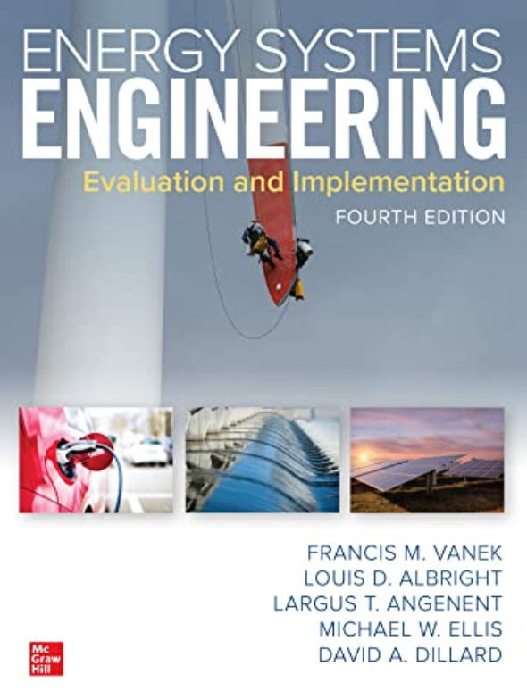
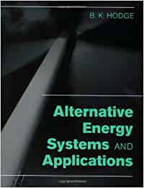
References
+ Instructor notes
Energy Systems Engineering: Evaluation and Implementation, 4th Ed.
McGraw-Hill, New York, 2020
Chapter 11 Solar-Thermal Technologies
Alternative Energy Systems and Applications Paperback
By Hodge

Slide 3
Solar Energy Systems
Part 1: Solar Thermal Technologies

Slide 4
Learning Outcome
The energy content and properties of the sunlight incident on the earth.
The design of a thermal solar collector.
Estimate the hourly and daily energy output of flat-plate solar collectors
Solar Rating & Certification Corporation (SRCC) certificate
Concentrating solar power (CSP) and associated Rankine power cycles

Slide 5
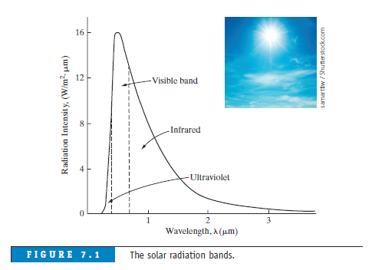
Solar Energy
Sun
Electromagnetic radiation
Wide spectrum of wavelengths & energy intensities
3 bands: Ultraviolet, Visible (48% useful for heating), Infrared
Amount of radiation available at a place depends on
Location
Season
Local landscape
Weather
Time of day
Other factors

Slide 6
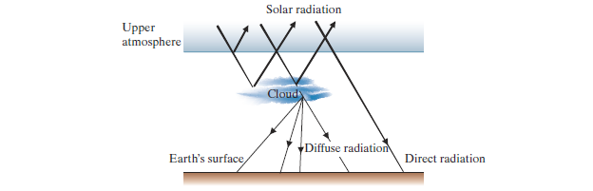
Direct and Diffuse Radiation
As solar energy passes through the Earth’s atmosphere, some of it is absorbed, some of it is scattered, and some of it is reflected by clouds, dust, pollutants, water vapor, etc.

Slide 7
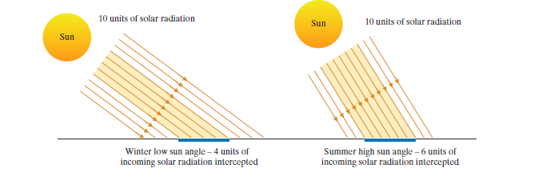
Variation of Solar Intensity
The rotation of the Earth – Hourly variations in sunlight
The lower angle of the Sun – The lower amount of radiation being intercepted by a horizontal surface

Slide 8
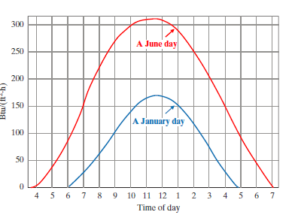
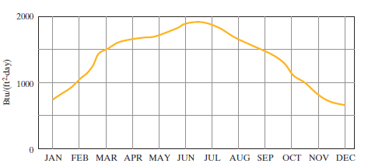
Hourly and Monthly Variation of Solar Intensity
The hourly peak values occur at solar noon, when the Sun is at the highest angle.
The higher intensity of solar radiation occurs during a day in June when compared to a day in January

Slide 9
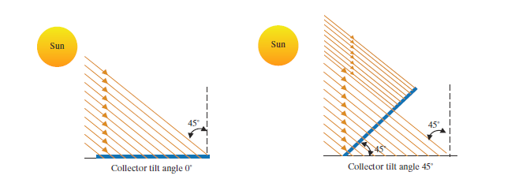
Solar Collector Installation
Tilt the collector so that its receiving surface is nearly perpendicular to the Sun’s rays.
Mechanical and economical considerations
  For all seasons’ usage – an angle equal to the latitude of the location
  For space heating (i.e., winter use) – an angle equal to about latitude plus 15 degrees

Slide 10
Solar space/water heating
Solar space heating may be accomplished using
an active system consisting of a solar collector which heats a working fluid which is circulated to heat a building
a passive system which heats the interior of the building directly as a result of building design and placement

Slide 11
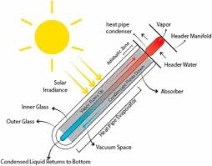
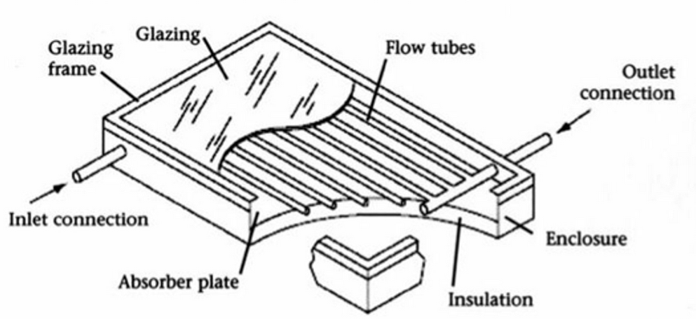
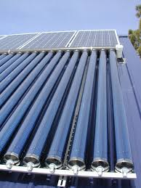
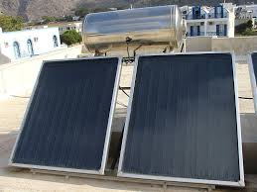
Solar collectors – Non-concentrating
(Residential)
Evacuated Tubes Flat-plate Solar Collectors

Slide 12
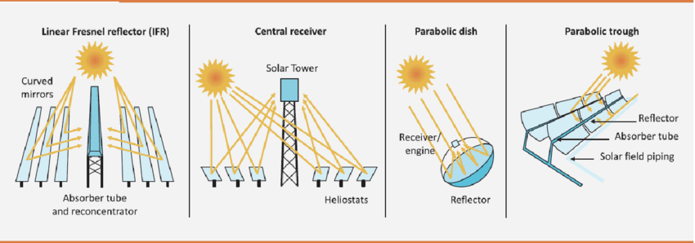
Solar collectors – Concentrating
(Industrial)

Slide 13
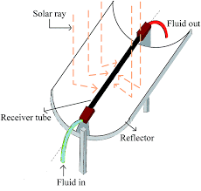
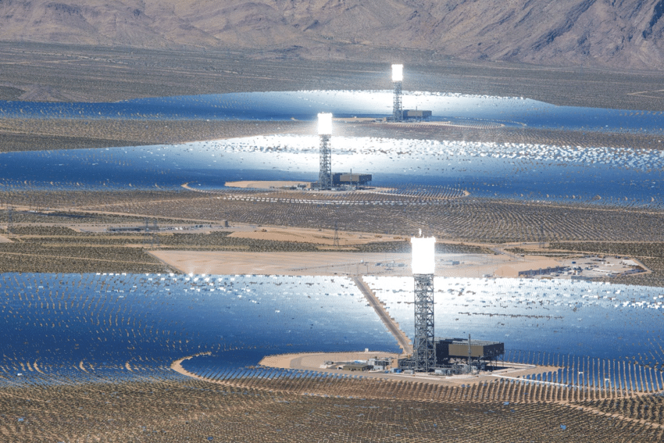
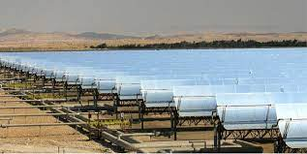
CSP
The Ivanpah Solar Electric Generating System (source: BrightSource Energy)
Unit 1: 126 MW
Units 2 and 3: 133 MW each.
Parabolic Troughs Heliostat Central Receivers

Slide 14
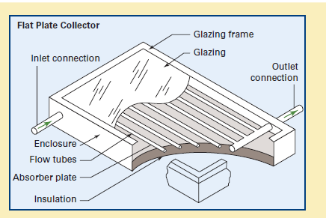
Solar collector design basis
Features of a solar collector
insulated box
transparent cover
absorbing plate
pipes to carry working fluid
Solar radiation enters through the transparent cover and is absorbed by the plate which heats and transfers heat to the working fluid.
Absorbed radiation is at short wavelength characteristic of the black body temperature of the sun (about 500 nm).
Energy re-irradiated from the plate is long wavelength characteristic of a black body at the operating temperature of the collector (about 8000 nm).

Slide 15
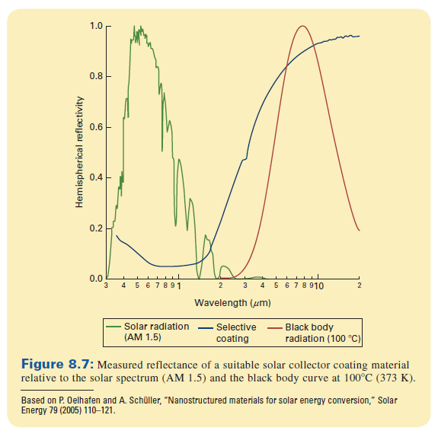
Minimizing energy loss
Energy loss is minimized by two mechanisms
conduction is minimized by insulation behind the plate
radiative losses are minimized if the transparent cover (i.e., glazing material) is transparent to short wavelength radiation and opaque to long wavelength radiation

Slide 16
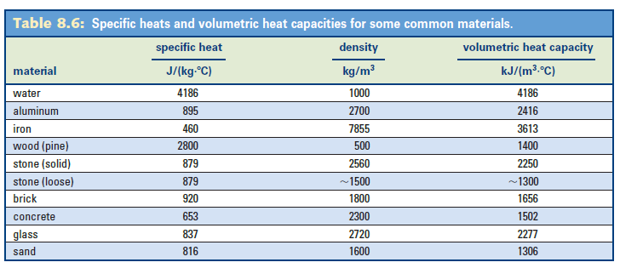
Heat storage
As solar radiation is not consistent throughout the day heat must be store to make the most effective use of this energy source.
Material may be heated during the day and heat extracted from that material during the night.
Heat available is

Slide 17
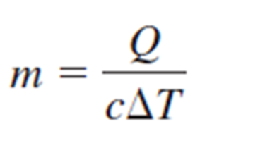
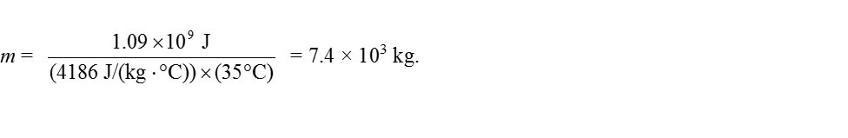
Heat storage requirement
To store the energy 1.09×10⁹ J in water with maximum and minimum temperatures of 65 °C and
30 °C requires a mass of
or

Slide 18
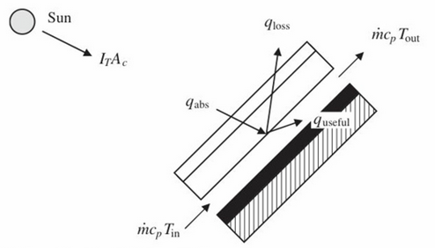
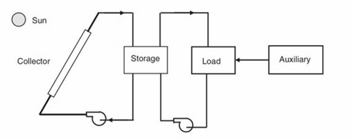
Flat Plate Collector System

Slide 19
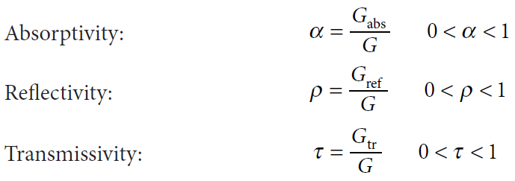
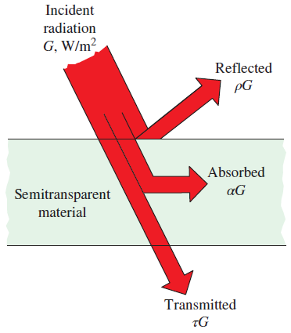



Absorptivity, Reflectivity, and Transmissivity
Irradiation, G: Radiation flux incident on a surface.
for opaque surfaces
Figure 3-8
The absorption, reflection, and transmission of incident radiation by a semitransparent material.

Slide 20






Collector Energy Balance
I_{T} Irradiation intensity
Ac Collector Area
τ Transmissivity
T_{ave} Average Collector Temperature
T_{a} Ambient temperature
U_{L} Collector’s overall conductance
α Absorptivity
T_{in} inlet water temperature
T_{out} outlet water temperature
Basis the collector analysis on collector average temperature is challenging→ The approach in the following slides is used to determine efficiency and losses of the collector

Slide 21

Collector Efficiency
The simple analysis expresses the collector efficiency in terms of the average collector temperature, T_{ave}. A more useful expression that involves T_{in} the inlet fluid temperature, can be cast as
Intercept Slope

Slide 22
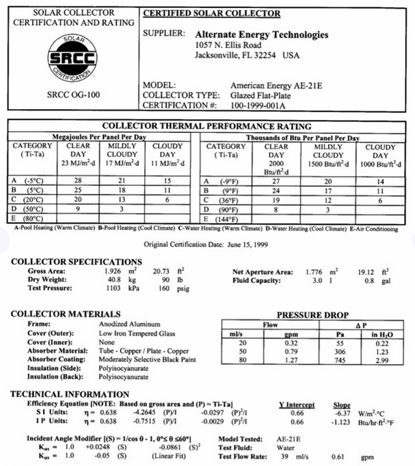
SRCC Certificate
Note: consistent with SRCC recommendations, the solar collector area is the gross area, not the aperture area
SRCC:
https://secure.solar-rating.org//Certification/Ratings/RatingsSummaryPage.aspx?type=1

Slide 23
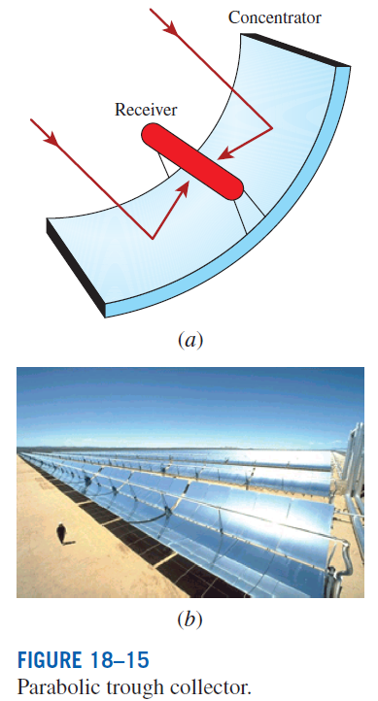

CONCENTRATING SOLAR COLLECTOR
For higher temperatures: Hot fluid (water, steam, air, or another fluid) at much higher temperatures can be produced using concentrating collectors by concentrating solar radiation on a smaller area.
Parabolic trough collector: The most common type of concentrating solar collector.
Conncentration factor: In a concentrating collector, solar radiation is incident on the collector surface, called aperture area A_{a} and this radiation reflected or redirected into a smaller receiver area A_{r}. The concentration factor CR is greater than one.
Parabolic trough collectors

Slide 24
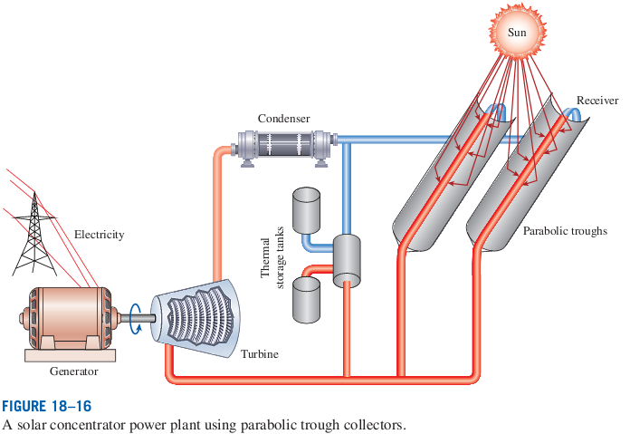
CONCENTRATING SOLAR POWER (CSP)
Temperatures in the receiver of a concentrating collector can reach 400°C.
The heated fluid can be used to drive a steam turbine for electricity production.
A solar concentrator power plant using parabolic trough collectors.

Slide 25
Solar Energy Systems
Part 2: Solar Photovoltaic (PV) Technologies

Slide 26
Learning Objectives
The basic physics of semiconducting materials and the properties of n-type and p-type materials.
The construction of a semiconducting junction device.
The production of electricity through the interaction of photons on semiconducting junctions.
The sensitivity and efficiency of photovoltaic devices.
Estimate the power produced by an array of PV modules based on product specification sheets

Slide 27
Solar Electric Generation
Electricity can be generated from solar radiation in two ways:
Conversion of solar radiation into heat to run a heat engine to drive a generator:
  Parabolic troughs
  Parabolic dishes
  Central receivers
Use of a photoelectric device: Photovoltaic devices are semiconducting devices that convert solar radiation (or any light) directly into electricity.

Slide 28
Semiconductors
Semiconductors act as insulators at low temperatures and conductors at higher temperatures.
Conduction occurs at higher temperature because the electrons surrounding the semiconductor atoms can break away from their covalent bond and move freely
The conductive property of semiconductors forms the basis for understanding how we can use these materials in electrical devices.
Silicon is the most commonly used semiconductor material as it forms the basis for integrated circuit (IC) chips and is the most mature technology and most solar cells are also silicon based

Slide 29
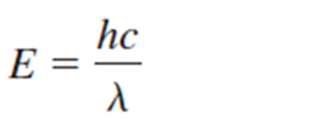
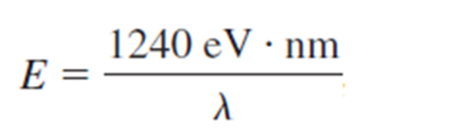
Photon energy
A photon has an energy related to its wavelength by
For energy in eV and wavelength in nm, this is

Slide 30
Electron-hole recombination
In principle the electron and hole could represent an electric current except that they attract one another and recombine.
In the band structure, the electron will fall back into the hole.
In the bonding picture the electron will fill the broken bond.
To avoid this we need to use two different types of semiconductor.

Slide 31
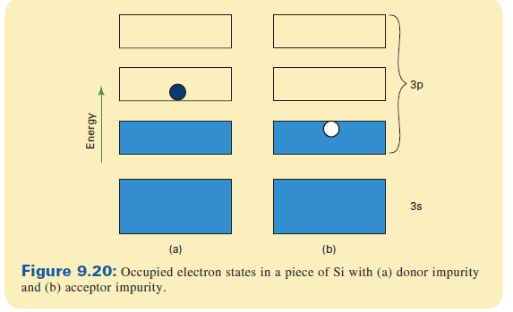
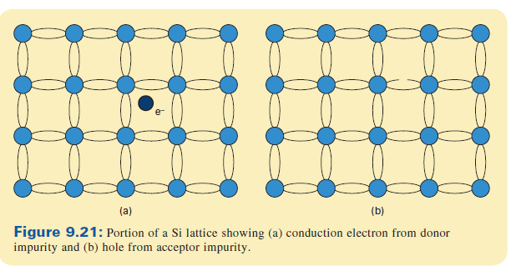
Doped semiconductors
A small amount of impurity can significantly alter the electrical properties of a semiconductor.
n-type impurities (donors) have one more valence
  electron than the host
p-type impurities (acceptors) have one less valence
electron than the host
These impurities create excess electrons or holes, respectively.

Slide 32
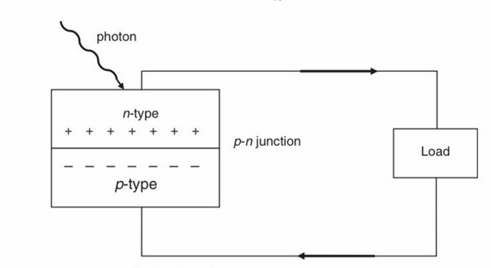
Semiconducting junctions
A p-n junction made of an n-type and a p-type semiconductor forms the basis of photovoltaic electricity. A semiconductor such as silicon is that a junction formed with n-type and p-type semi-conductor materials enhances the flow of electrons and holes.

Slide 33
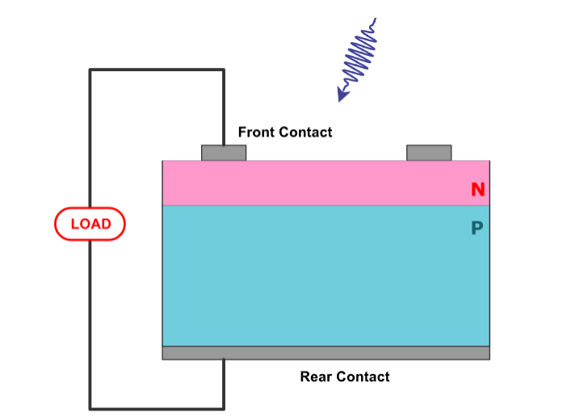
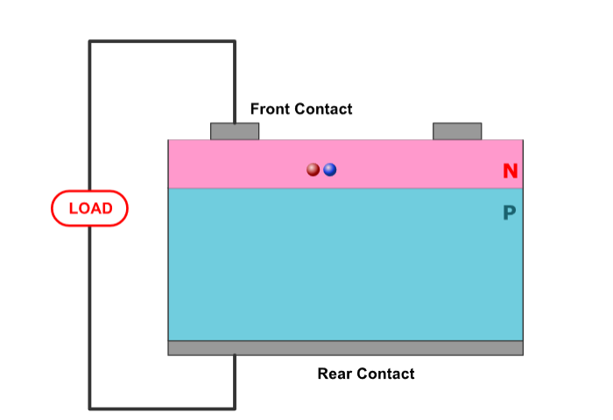
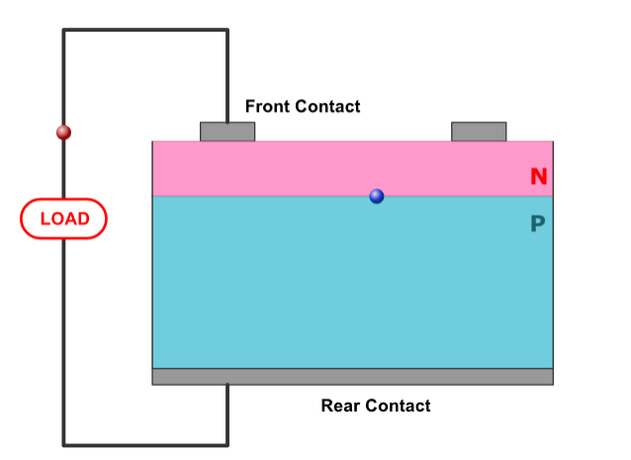
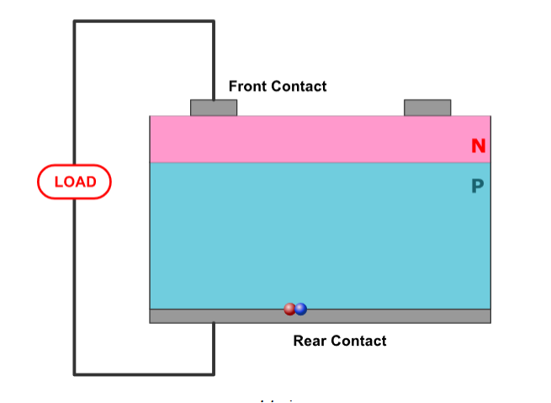
Operation of PV Cells
If the incident photon is energetic enough to dislodge a valence electron, the electron will jump to the conduction band and initiate a current flow. For an electron to be forced from the valence band to the conduction band, the electron must possess at least the band gap energy.

Slide 34
Characteristics of photovoltaic cells
Band Gap Energy
In order to create electron-hole pairs (an hence an electric current) photons must have energy equal to (or greater than) the energy associated with the energy gap.
Different semiconducting materials have different energy gaps and hence different spectral responses.

Slide 35
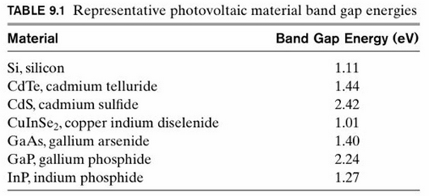
Band Gap Energy
Photon’s energy:
For an electron to be forced from the valence band to the conduction band, the electron must have gained at least the band gap energy from interaction with photon.

Slide 36
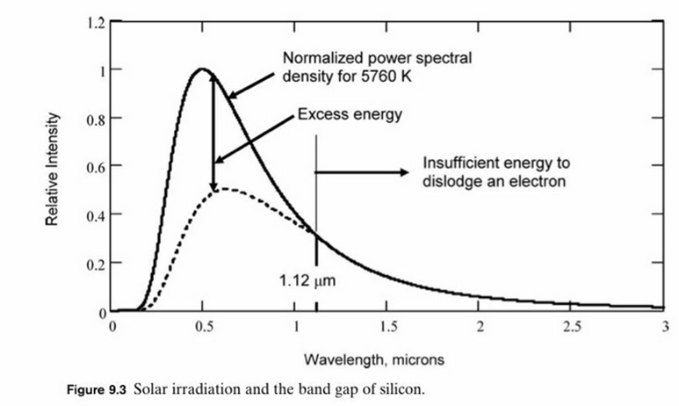
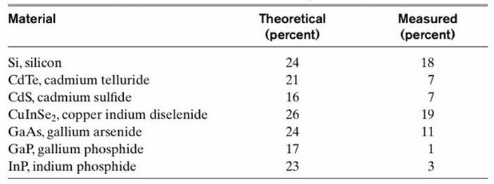
Excess Energy and Cell Efficiency

Slide 37
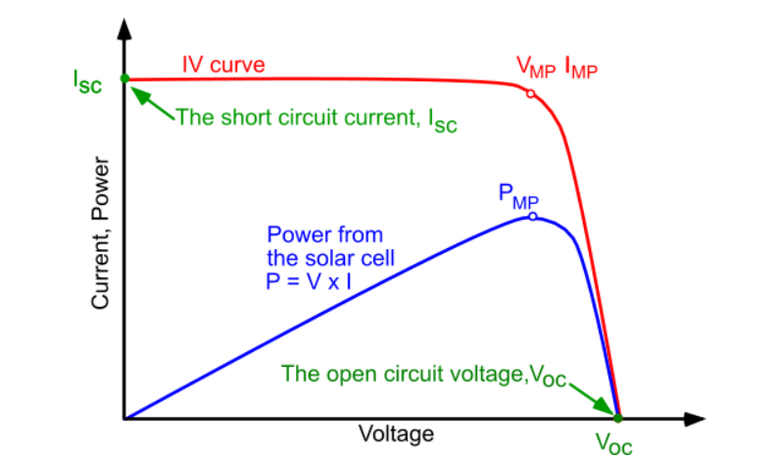
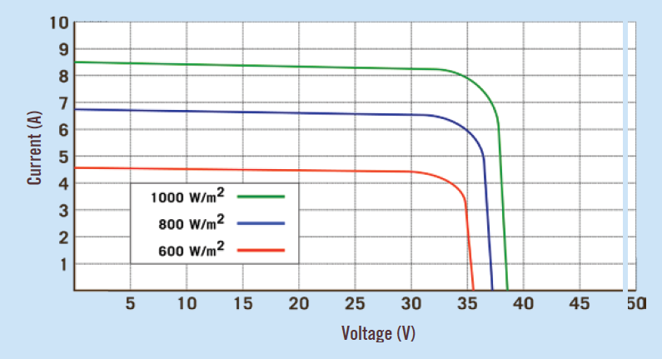
Photovoltaic Cell Performance
Current voltage (IV) cure of a solar cell. To get the maximum power output of a solar cell it needs to operate at the maximum power point, P_{MP}.

Slide 38
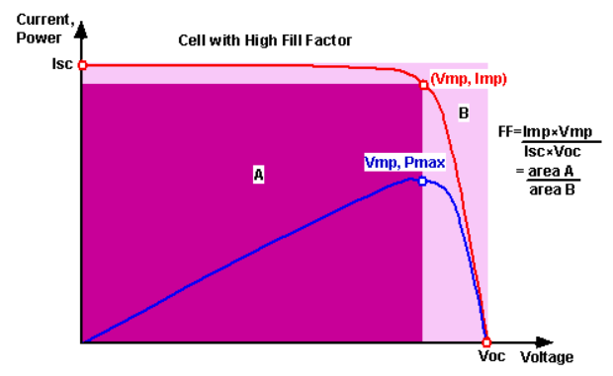

Fill Factor
Fill factor (FF) is used to evaluate the actual maximum value of P relative to this upper bound;
NOTE: FF is different than efficiency

Slide 39
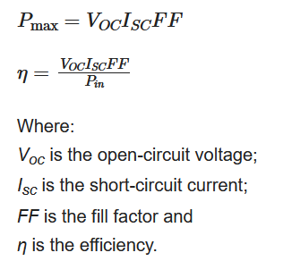
Efficiency
The efficiency of a solar cell is determined as the fraction of incident power which is converted to electricity and is defined as:

Slide 40
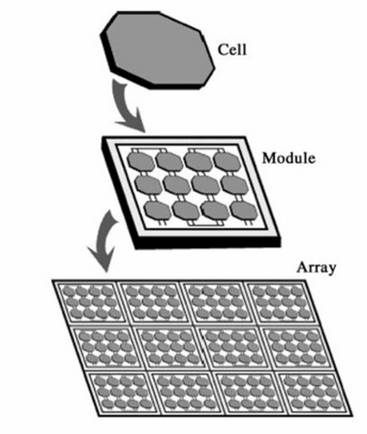
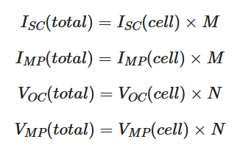
PV Modules
N is the number of cells in series;
M is the number of rows;
M x N is the number of cells required (based on power, W) required)

Slide 41
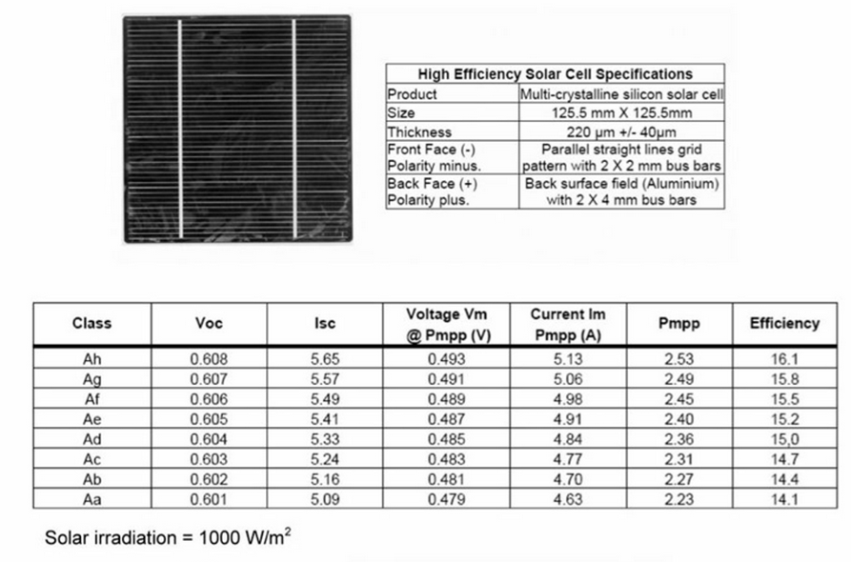
Standard Test Conditions (STC)
PV cells and panels are rated at Standard Test Conditions (STC) of
1000 W/m²
and 25 C

Slide 42
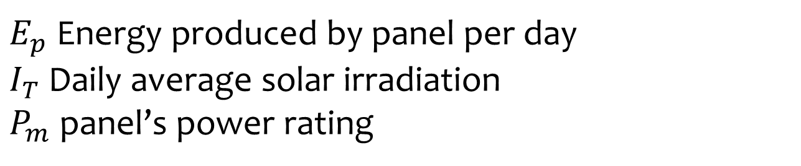
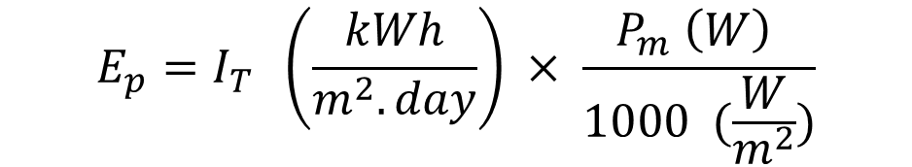
Estimating Energy Production
$$E_{p}=I_{T} \left(\frac{kWh}{m^{2}.day}\right) × \frac{P_{m} \left(W\right) }{1000 (\frac{W}{m^{2}})}$$
$E_{p}$Energy produced by panel per day
$I_{T}$Daily average solar irradiation
$P_{m}$panel’s power rating

Slide 43
Photovoltaic Systems
The two principal classifications of photovoltaic systems are stand-alone and grid-connected (or utility interactive). Stand-alone photovoltaic systems are not connected to the electric grid. Functional uses for a hierarchy of increasing complexity of photovoltaic systems are as follows:
Direct-coupled
Systems with battery storage
Systems with backup (generator) power
Hybrid power systems
Systems connected to the electric grid
System for utility power production

Slide 44
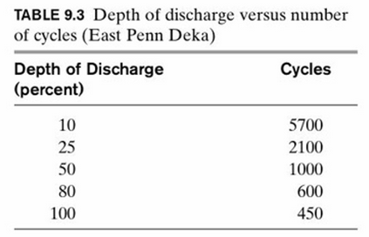
Solar PV Batteries
Cycle capability refers to the number of charge/discharge cycles expected from the battery.
The depth of discharge specifies how much (what percentage) of the stored energy at full capacity may be extracted without damage to the battery.
Batteries for photovoltaic applications require high cycle capacity as well as high depth of discharge capability.
Automotive batteries require a large amount of power draw over a short period of time (engine cranking time) with a low depth of dis- charge. Thus, automotive batteries are not suitable for solar storage applications.

Slide 45


PV Systems
Direct-coupled
Systems with battery storage

Slide 46


PV Systems
Hybrid system
A rectifier is used to convert AC from an AC generator to DC for battery charging.
Grid Connected

Slide 47
Solar data

Slide 48


tableun_07_03

Slide 49


tableun_07_05

Slide 50


tableun_07_07

Slide 51


tableun_07_09

Slide 52


tableun_07_11

Slide 53


tableun_07_13

Slide 54

Average Monthly Data Sample

